Slide 1
17 Nove
mber 2024
Bennet
University
Disaster Tweets: NLP Project Presentation

Slide 2

Bennett University
17 November 2024
Introduction
Overview of NLP project focus

Slide 3
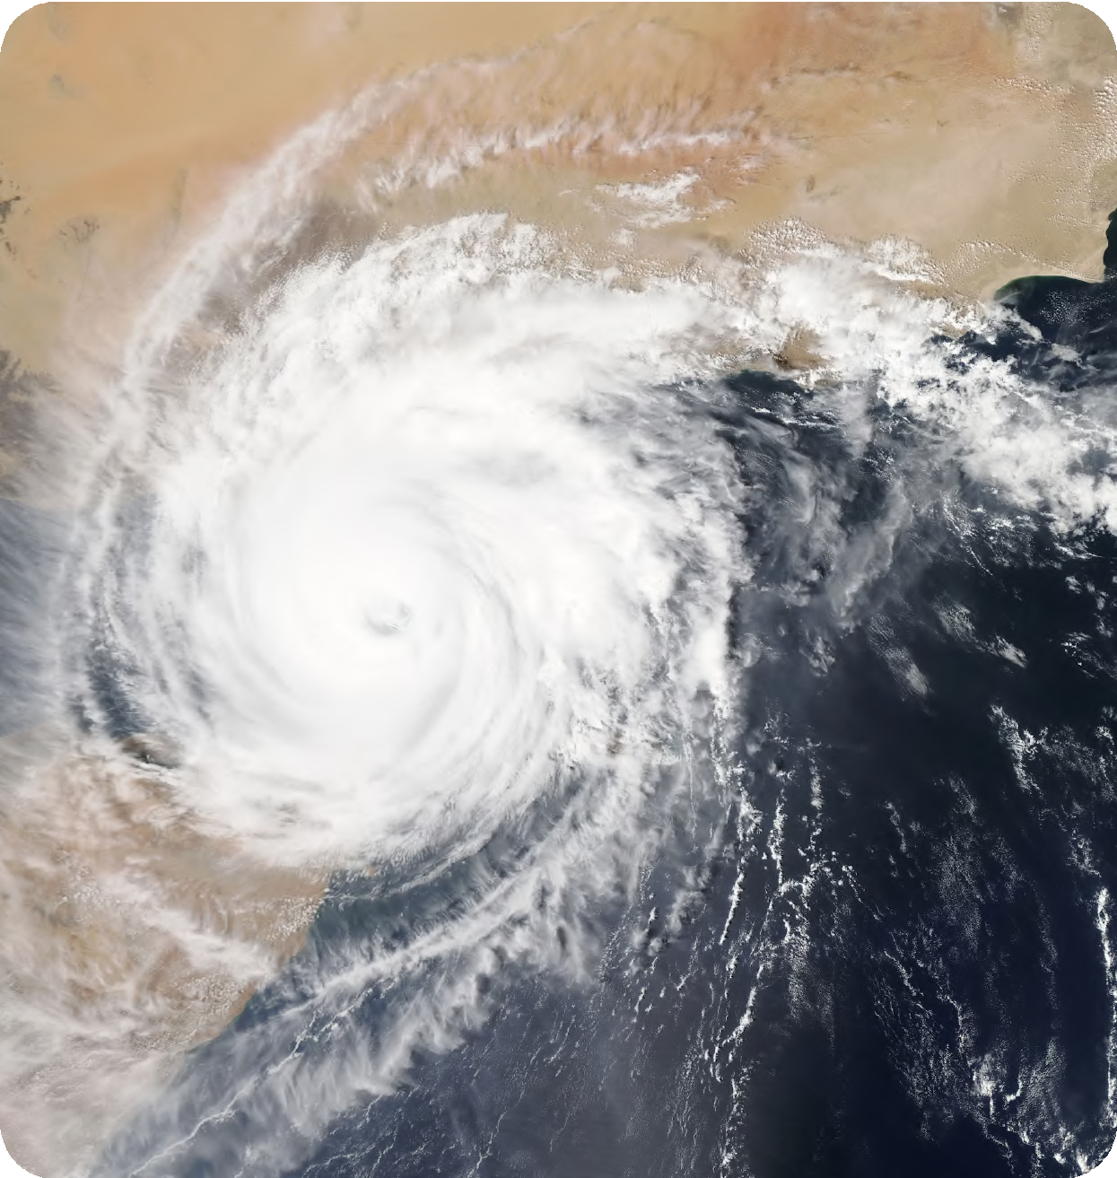
Bennett University
17 November 2024
Problem Statement
Identifying disaster tweets using machine learning

Slide 4

Dataset Details
Bennett University
17 November 2024
Understanding the source, size, and unique characteristics of the dataset is crucial for the success of any machine learning project. It provides the foundation for data preprocessing, feature engineering, and model selection.The primary dataset used in the Natural language processing with disaster tweets
Available on Kaggle, which includes information like id, keyword, location, target, text etc.

Slide 5



Methodology Steps
Bennett University
17 November 2024
Preprocessing
Selection
Prepare data for analysis
Create new features
Engineering
Evaluation
Choose the best model
Assess model performance

Slide 6


Results
Bennett University
17 November 2024
Label
Label
200
The Results slide is where we showcase the key findings and performance metrics of our Natural Language Processing with Disaster Tweets project. This is where we unveil the impact of our machine learning models and algorithms through a visually
150
appealing line chart.
100
50
0
First value
Second value
Third value
Fourth value
Fi h value
Sixth value
Seventh value
Eighth value

Slide 7



Challenges
Bennett University
17 November 2024
Resilience
Opportunities
Success
Overcoming project hurdles with
Turning obstacles into opportunities for growth.
Navigating through difficulties towards success.
resilience.

Slide 8


Conclusions
Bennett University
17 November 2024
In this slide, we will discuss the summary of project outcomes and implications. It is crucial to reflect on the results obtained and what they mean for the future direction of the project.

Slide 9
Future Work
Bennett University
17 November 2024
11
7
5
4
7
7
6
4
3
5
3
4
3
2
1
1
1
1
1
0
One
Two
Three
Four
Five
One
Two
Three
Four
Five
One
Two
Three
Four
Five
Innovation Growth
Trend Analysis
Market Share
Explore new ideas.
Track performance.
Identify opportunities.

